Slide 1


Certification CDSD Block 1 & 3
August 28th, 2025 – Louis Le Pogam

Slide 2
Agenda
Block 1 - Build & Manage a Data Infrastructure – Kayak Project
Block 3 – Unsupervised Machine Learning – Uber Pickups Project

Slide 3

Project Reminder
Project
Kayak would like to create a holiday recommendation application based on :
Weather
Hotels in the area
Based on real-time data
Goal
Get the needed data as following:
Scrape data from destinations
Get weather data and hotels’ info from each destination
Store all the information above in a data lake
Extract, transform and load cleaned data from your datalake to a data warehouse

Slide 4
4 building blocks for the data scraping model
Description
1
Geolocation
Processing of list of cities by obtaining GPS coordinates and INSEE codes with API
Saving all data to CSV for weather queries
2
Weather Data
Retrieving 7-day weather forecasts for cities based on INSEE codes
Ranking cities based on customizable criteria and creates aggregated rankings
Saving ranked list based on number of favorable days to CSV
3
Booking Website Scraping
Taking the top 5 cities based on previous analysis
Searching for hotels in each city available on booking.com
Saving in into a JSON file
4
Data Transformation & Storage
Removing low rated hotels and identifying consecutive night availability
Creating interactive visualizations and storing results in AWS S3 (data lake) and an AWS RDS-hosted SQL relational database

Slide 5
All 4 blocks are used to get the final output
Geolocation
get_coordinates
Data Transformation and Storage
get_weather_data
get_city_ranking
Weather Data
Scrapy crawl
Open saved JSON
get_weather_data
get_city_ranking
Output stored on S3 Datalake - Weather and hotel data - Visualization of available hotel for top cities
Output stored on SQL database - Weather and hotel data
Booking Website Scraping

Slide 6
The weather module scraps the weather by city and ranks them based on defined ideal conditions
get_weather_data
get_city_ranking
Reads a list of French cities from a file based on the INSEE code
Connects to a weather service (Meteo Concept API) for each city
Gathers 7-day forecasts including: - Daily rainfall predictions - Temperature highs and lows - Wind speed information
Organizes everything in a DataFrame where each row represents one day's weather forecast for a specific city
Flags Less-Than-Ideal Weather Days when: - Too hot / Too cold / Too rainy / Too windy - Default value: 35°C / 20°C / 10mm / 50 km/h - Can be changed depending on the season
Calculates Problem Days for each city over the forecast period
Ranks Cities by: - Fewest problematic weather days - Lowest average rainfall as tiebreaker
Output : DataFrame with weather prediction for eachs targeted cities
Output : DataFrame with a prioritized list of cities with optimal weather conditions for travelers

Slide 7
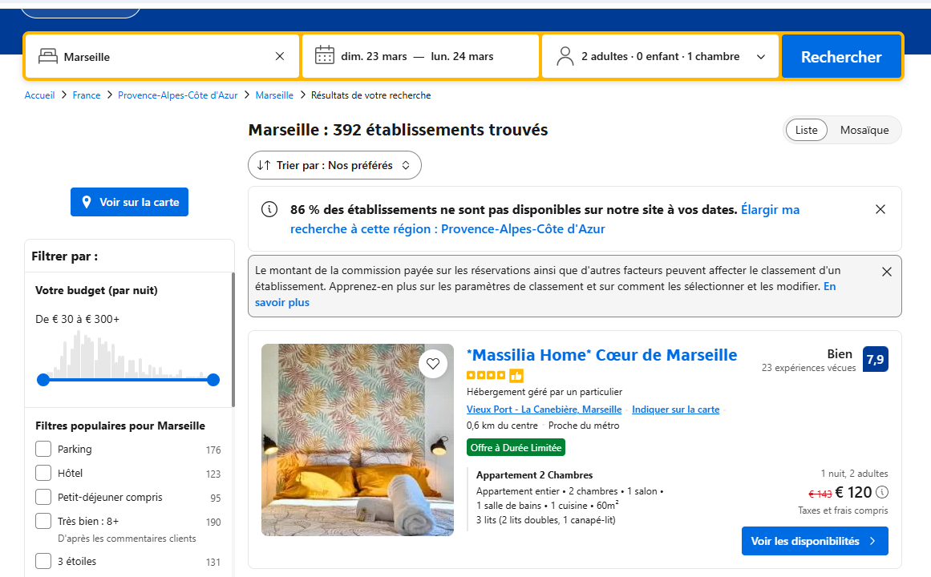
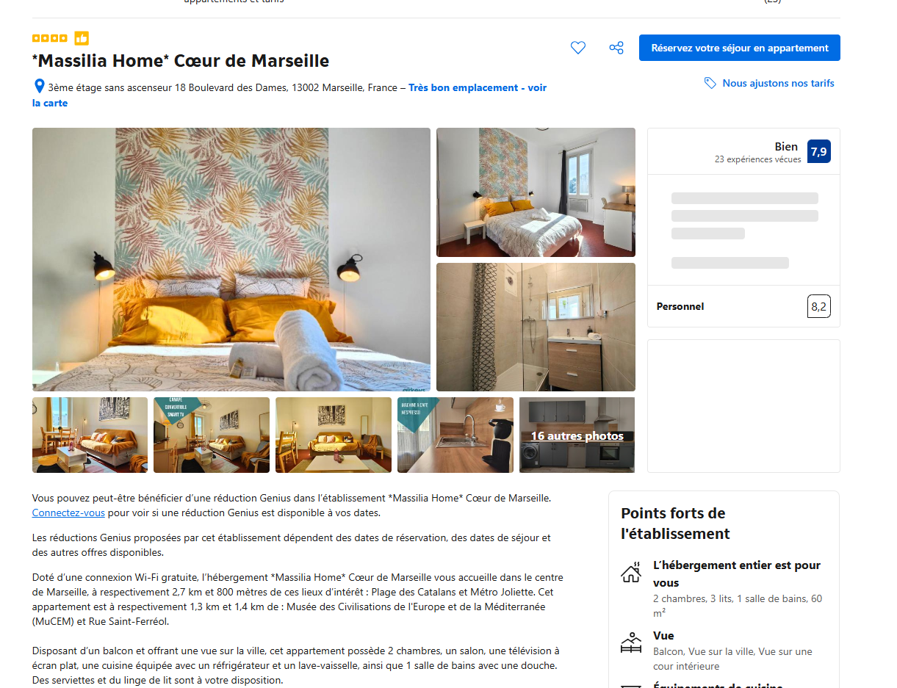
700 pages scrapped to get the available hotels of the next 7 days
Get Weather Data
Open file of ranked cities and select top 5
Get URL for each city and date
Loop on each cities and for the next 7 days
Get the URL of the search for each city x date
Get the Details from the Search Results
For each results on the search page, get the main info : Name, ranking, price, distance…
Keep only 20 first results to limit output size
Open each page and get detailed data
For each hotel, open the hotel page to get detailed info : Adress, latitude, longitude, description, URL…
Store Data in a JSON file
Gather all data in one JSON
700 pages scrapped (5 cities x 20 hotels x dates x 7 dates) in 6 minutes

Slide 8
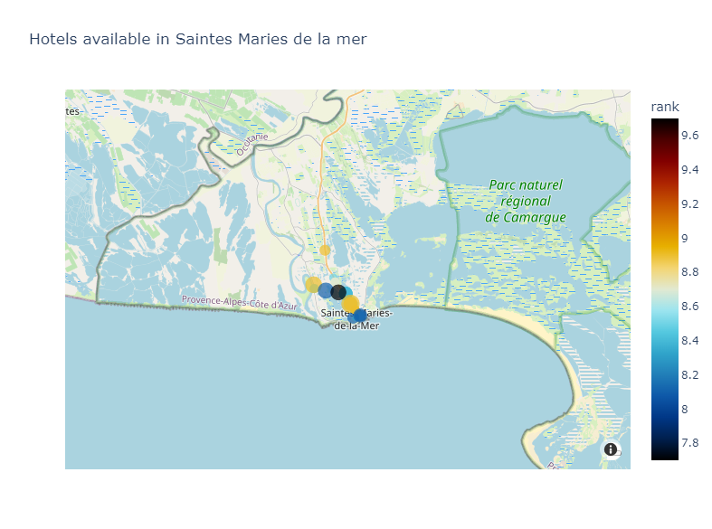
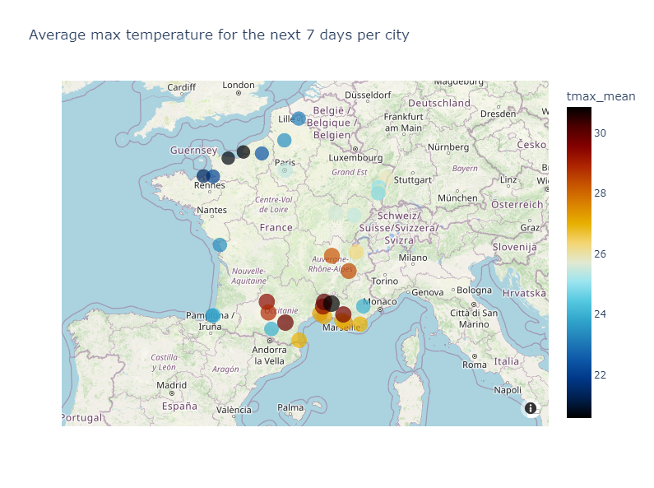
All outputs are stored on an AWS S3 and SQL server and ready to be used
Output 1 : All database
Output 2 : Visualization of available hotels for each top 5 cities
Output 3 : Overview of average temperature for the next 7 days of all targeted cities
Dataframe with weather forecast
Dataframe with City Ranking
JSON with all booking.com data scrapped
All outputs are stored in a S3 and SQL database and ready to be extracted and used

Slide 9
Q&A

Slide 10
Agenda
Block 1 - Build & Manage a Data Infrastructure – Kayak Project
Block 3 – Unsupervised Machine Learning – Uber Pickups Project

Slide 11

Project Reminder
Uber’s Challenge
Drivers are not always located where and when riders need them
This mismatch leads to longer wait times and reduced efficiency
Project Goal
Detect real-time “hot zones” of high demand
Provide actionable recommendations for driver reallocation
Enable intuitive visualization for rapid decision-making

Slide 12
3 steps to define the hot zone
1
Exploratory Data Analysis
2
Model Selection
3
Real Time “Hot-Zone” Recommendation

Slide 13
3 steps to define the hot zone
1
Exploratory Data Analysis
2
Model Selection
3
Real Time “Hot-Zone” Recommendation

Slide 14
Uber has provided a cleaned database ready to be used
Dataset description
Preprocessing
Dataset of April 2014 used with 564k lines
4 columns: - Date - Latitude - Longitude - Base : Internal code, not used in the analysis
Preprocessing limited to converting the date column into several sub-columns
Focus on New York City inside this latitude and longitude line : - Latitude minimum = 40.4774 - Latitude maximum = 40.9176 - Longitude minimum = -74.2591 - Longitude maximum = -73.7004
Limited preprocessing performed on the database

Slide 15
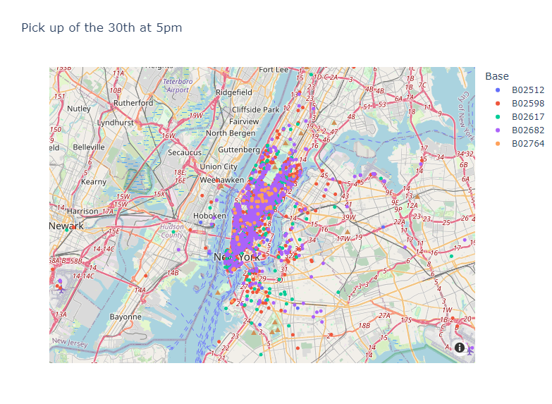
Database Overview: Each point corresponds to a single ride

Slide 16
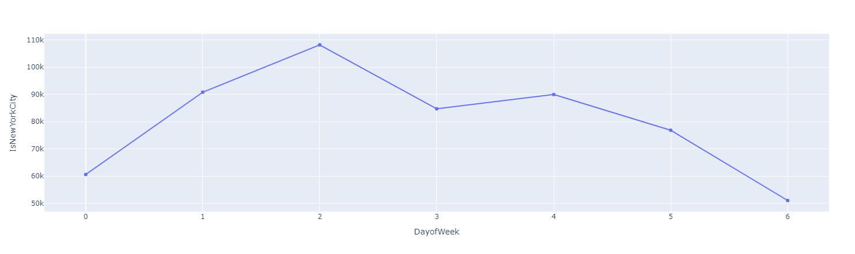
Monday and Sunday are the lowest day while the peak in on Wednesday
Number of pickups per Day | April 2014, NYC only, 0 = Monday
Monday
Tuesday
Wednesday
Thursday
Friday
Saturday
Sunday

Slide 17
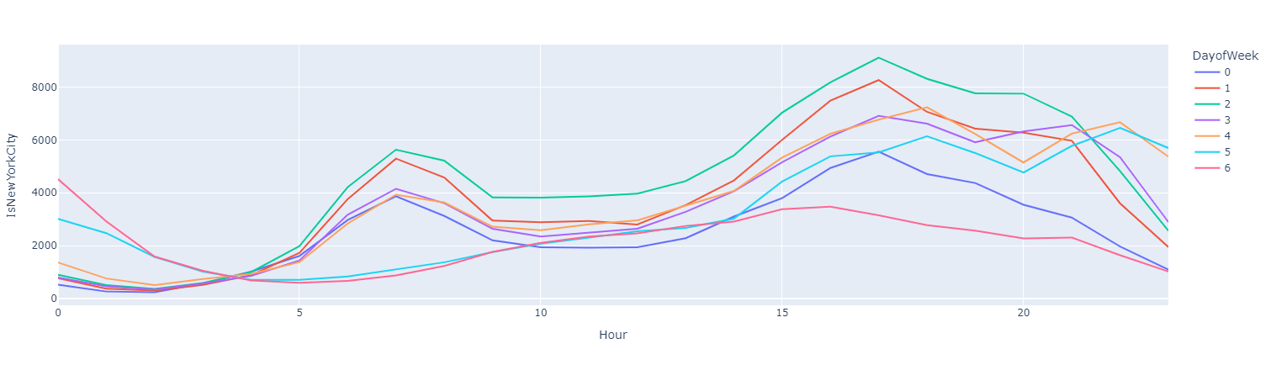
During the week, there is a peak at 7am then between 5pm and 8pm while the night is busy during the weekend
Number of pickups per Hour depending on the day | April 2014, NYC only, 0 = Monday

Slide 18
3 steps to define the hot zone
1
Exploratory Data Analysis
2
Model Selection
3
Real Time “Hot-Zone” Recommendation

Slide 19
2 models can be chosen to define the hot zone
Kmeans Clustering
DBScan
Principle
Centroid-based clustering algorithm
Density-based clustering algorithm
Shape
Spherical only
No shape
Strengths
Simple and fast
Works well when clusters are spherical
No need to know number of clusters
Handle complex shapes
Weaknesses
Number of clusters must be known
Sensitive to initialization and outliers
Poor performance on irregularly shape
Commutationnally heavier
Rationale for using it
Speed and simplicity when number of clusters is known
Complex shapes and number cluster not known
Seems more adapted to handle real-time data

Slide 20
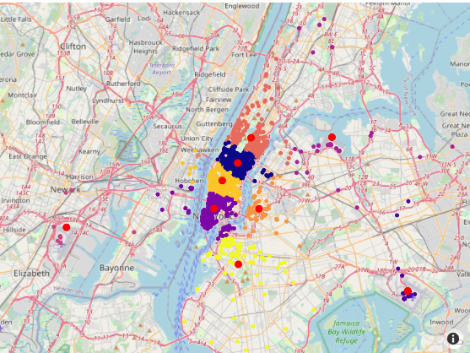
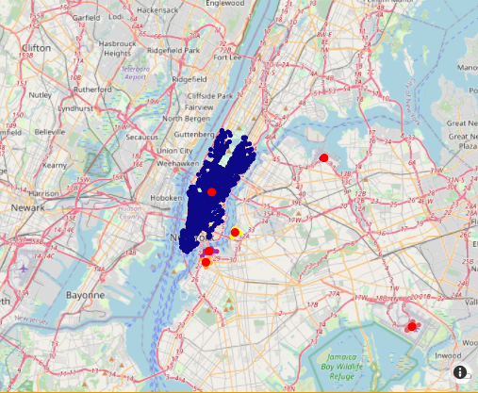
DBScan was chosen for hot zone recommendation
Kmeans Clustering
DBScan
Details
Elbow and silhouette methods to get the optimal number of clusters
9 clusters seems to be the best for April 30th
Details
Parameters : Epsilon = 0.15 / Min Sample = 10
6 clusters + outliers
Cluster Overview
Cluster Center Overview
Best model to handle variability in cluster location

Slide 21
3 steps to define the hot zone
1
Exploratory Data Analysis
2
Model Selection
3
Real Time “Hot-Zone” Recommendation

Slide 22
Hot zones are dynamically calculated with the DBScan algorithm
Plot_hot_zone function
Input
Dataset, day of the week, hour, dbscan parameters
Calculation
For any given hours, would calculate the clusters center and plot them
Hot zones can be dynamically calculated and provided to the drivers at any given day and time of the week
Output
A map with the hot zones of this hour
Real-time visualization
For a given day, the evolution of hot spots can be shown by looping over different hours

Slide 23
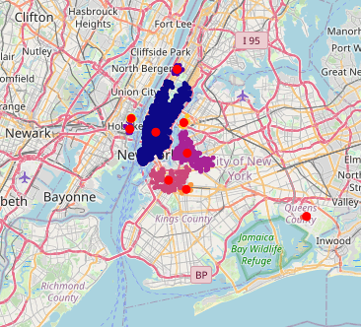
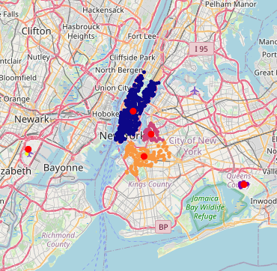
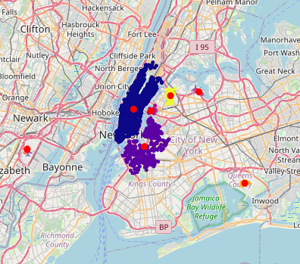
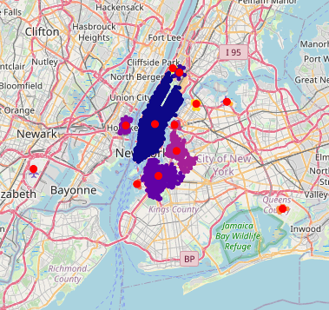
The hot zone are changing every hour of the day
Evolution of hot zones for a Saturday at 12am, 6am, 12pm, 6pm
12am
6am
12pm
6pm

Slide 24
Q&A

Slide 25

Thanks!

